Slide 1







Processing XML in .NET
DOM Parser, Streaming Parser, XPath, LINQ to XML
Database
Applications
SoftUni Team
Technical Trainers
Software University
http://softuni.bg

Slide 2
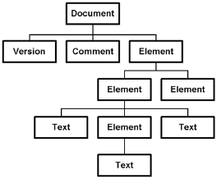


Table of Contents
XML Processing in .NET
Using the DOM Parser
Using the Streaming Parser
Using XPath to Search in XML Documents
Using LINQ to XML
XSL Transformation in .NET

Slide 3
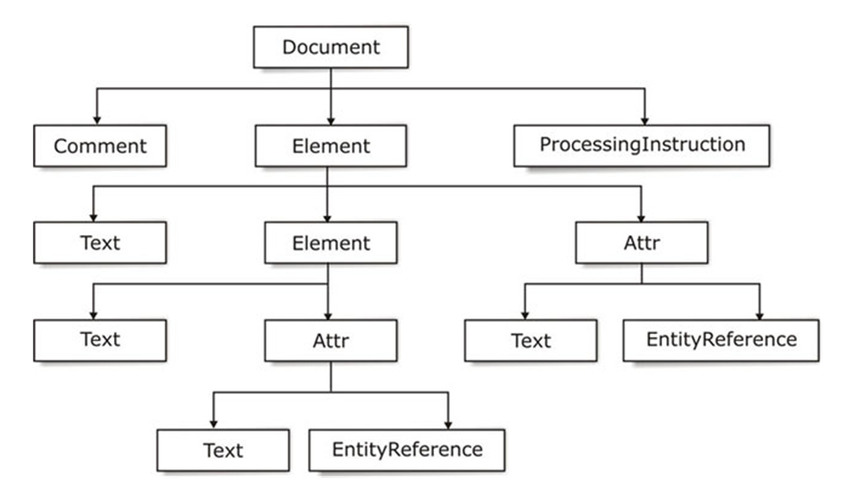
The DOM Parser
Parsing XML Documents as DOM Trees

Slide 4
The DOM Parser
Suppose we have the following XML document:
<?xml version="1.0"?>
<library name=".NET Developer's Library">
<book>
<title>Professional C# 4.0 and .NET 4</title>
<author>Christian Nagel</author>
<isbn>978-0-470-50225-9</isbn>
</book>
<book>
<title>Silverlight in Action</title>
<author>Pete Brown</author>
<isbn>978-1-935182-37-5</isbn>
</book>
</library>

Slide 5
The DOM Parser (2)
The corresponding DOM tree:
Header (prolog)
Root element

Slide 6
The DOM Parser in .NET – Example
XmlDocument doc = new XmlDocument();
doc.Load("library.xml");
XmlNode rootNode = doc.DocumentElement;
Console.WriteLine("Root node: {0}", rootNode.Name);
foreach (XmlAttribute atr in rootNode.Attributes)
{
Console.WriteLine("Attribute: {0}={1}", atr.Name, atr.Value);
}
foreach (XmlNode node in rootNode.ChildNodes)
{
Console.WriteLine("\nBook title = {0}", node["title"].InnerText);
Console.WriteLine("Book author = {0}", node["author"].InnerText);
Console.WriteLine("Book isbn = {0}", node["isbn"].InnerText);
}

Slide 7
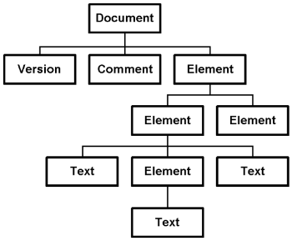
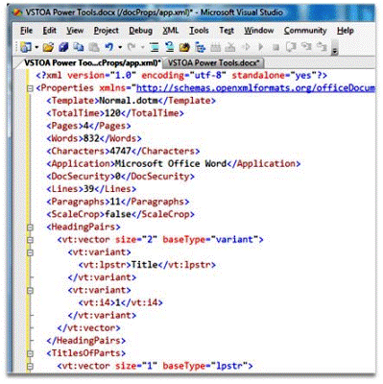

Parsing XML Document with the DOM Parser
Live Demo

Slide 8
.NET Classes to Work with DOM
The DOM parser provides few important classes:
XmlDocument
Represents the DOM tree
Usually contains two elements:
Header part (prolog)
The root element of the XML document
XmlNode
Abstract base class for all nodes in a DOM tree

Slide 9
.NET Classes to Work with DOM (2)
XmlElement
Represents a XML element
XmlAttribute
Represents an attribute of an XML tag (couple name-value)
XmlAttributeCollection
List of XML attributes attached to an element
XmlNodeList
List of XML DOM nodes

Slide 10
The XmlNode Class
The class System.Xml.XmlNode:
Fundamental for the DOM processing
Represents a base node
Its inheritor-classes are:
XmlDocument, XmlElement, XmlAttribute, XmlDeclaration, …
Allows navigation in the DOM tree:
ParentNode – returns the parent node (null for the root)

Slide 11
The XmlNode Class (2)
PreviousSibling / NextSibling – returns the left / right node to the current node
FirstChild / LastChild – returns the first / last child of the current node
Item[name] (indexer [] in C#) – returns the first child by name
Working with the current node:
Name – returns the name of the node (element, attribute, …)
Value – gets the node value
Meaningful for text nodes and attributes

Slide 12
The XmlNode Class (3)
Attributes – returns the node attributes (with values) as XmlAttributeCollection
InnerXml, OuterXml – returns the part of the XML containing the current node
Respectively with or without the node itself
InnerText – concatenation of the values of the node and its child elements over the tree (recursively)
NodeType – returns the node type (document, element, attribute, text, whitespace, comment, processing instruction, …)

Slide 13
The XmlNode Class (4)
Modifying the current node:
AppendChild(…) / PrependChild(…)
Inserts new child after / before all other children of the current node
InsertBefore(…) / InsertAfter(…)
Inserts new child before / after given inheritor
RemoveChild(…) / ReplaceChild(…)
Removes / replaces given child

Slide 14
The XmlNode Class (5)
RemoveAll()
Deletes all children of the current node (element, attribute …)
Value, InnerText, InnerXml
Reads / changes the value / text / XML text of the node

Slide 15
The XmlDocument Class
The System.Xml.XmlDocument:
Contains XML document represented as DOM tree
Loading and saving XML document
From file, from stream, from strings, etc.
Load(…), LoadXml(…), Save(…)
Important properties, methods and events:
DocumentElement – returns the root element

Slide 16
The XmlDocument Class (2)
Important properties, methods and events:
PreserveWhitespace – indicates if the white space to be kept during save or load
CreateElement(…), CreateAttribute(…), CreateTextNode(…)
Creates new XML element, attribute or value for the element
NodeChanged, NodeInserted, NodeRemoved – events for tracking the changes in the document

Slide 17





Modifying XML Document Using the DOM Parser
Live Demo

Slide 18




The .NET Streaming Parser
Using XmlReader and XmlWriter

Slide 19
SAX and StAX Parsers
SAX-style parsers are 'push' parsers
'Push' data to the application with callbacks
Event handlers for processing tags, attributes, data, etc.
StAX-like parsers are 'pull' parsers
'Pull' data from the parser as needed → simplified development
The application moves the document's cursor forward
Just like reading a stream
XmlReader is a StAX-style (streaming) parser

Slide 20
SAX, StAX and XmlReader
XmlReader class
Implements a streaming XML parser in .NET (StAX style)
XmlReader is abstract class, which:
Provides read-only access to the XML data
Works like a stream, but reads XML documents
Works in forward-only mode
Reads data at each step
Tags, attributes, text, whitespace, etc. can be extracted and analyzed

Slide 21
The XmlReader Class
The XmlReader class – methods and properties:
Read() – reads next node from the XML document or returns false if no such node
NodeType – returns the type of the read node
Name – returns the name of the read node (name of the last read element, attribute, …)
HasValue – returns true if the node has value
Value – returns the node value
ReadElementString() – reads the value (the text) from the last read element

Slide 22
The XmlReader Class (2)
AttributeCount, GetAttribute(…) – extract the attributes of the current element
XmlReader is an abstract class
Instantiated with the static method Create(…)
Implements IDisposable (put it in using() { … } block)
using (XmlReader reader = XmlReader.Create("items.xml"))
{
while (reader.Read()) { … }
}

Slide 23


Parsing XML with XmlReader
Live Demo

Slide 24
Working with XmlWriter
The class XmlWriter creates XML documents
Works as a stream, but writes tags and data into XML documents
Most important methods:
WriteStartDocument() – adds the prolog part in the beginning of the document (<?xml … />)
WriteStartElement(…) – adds opening tag
WriteEndElement() – closes the last tag
WriteElementString(…) – adds an element by given name and text value

Slide 25
Working with XmlWriter (2)
WriteAttributeString(…) – adds an attribute to the current element
WriteEndDocument() – closes all tags and flushes the internal buffer (by calling Flush())
XmlWriter is an abstract class, use XmlTextWriter instead
Implements IDisposable
using (var writer = new XmlTextWriter ("items.xml"))
{
// Write nodes here
}

Slide 26


Creating XML with XmlWriter
Live Demo

Slide 27

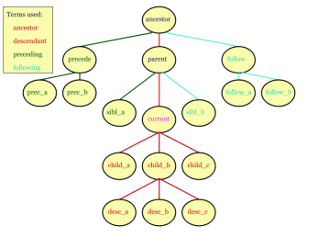
Using XPath

Slide 28
Using XPath in .NET
XmlNode (the DOM parsed) supports XPath operations:
SelectNodes(string xPathExpression)
Returns list of all nodes matched by the specified XPath expression
SelectSingleNode(string xPathExpression)
Returns the first node matched by the specified XPath expression
More powerful XPath functionality is available in the System.Xml.XPath namespace

Slide 29

XPath and XmlNode – Example
Suppose we want to find all <item type="beer"> nodes
<?xml version="1.0" encoding="windows-1251"?>
<items>
<item type="beer">
<name>Zagorka</name>
<price>0.75</price>
</item>
<item type="food">
<name>sausages</name>
<price>0.48</price>
</item>
<item type="beer">
<name>Kamenitza</name>
<price>0.65</price>
</item>
</items>
XPath selector:
/items/item[@type='beer']

Slide 30
XPath and XmlNode – Example (2)
static void Main()
{
XmlDocument xmlDoc = new XmlDocument();
xmlDoc.Load("../../items.xml");
string xPathQuery = "/items/item[@type='beer']";
XmlNodeList beersList = xmlDoc.SelectNodes(xPathQuery);
foreach (XmlNode beerNode in beersList)
{
string beerName = beerNode.SelectSingleNode("name");
Console.WriteLine(beerName.InnerText);
}
}

Slide 31



Searching with XPath in XML Documents
XPath
Live Demo

Slide 32

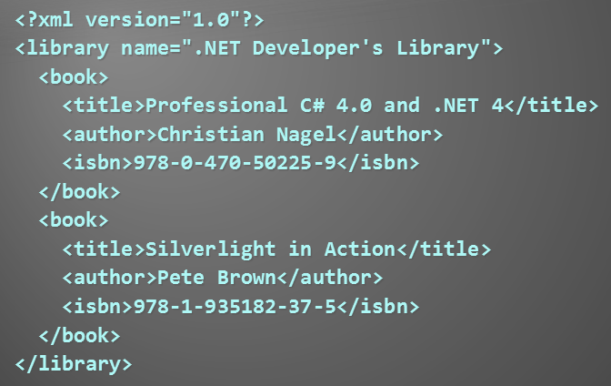
LINQ to XML
LINQ
XML

Slide 33
LINQ to XML
LINQ to XML
Use the power of LINQ to process XML data
Easily read, search, write, modify XML documents
LINQ to XML classes:
XDocument – represents a LINQ-enabled XML document (containing prolog, root element, …)
XElement – represents an XML element in LINQ to XML
Methods: Parse(…), Save(), RemoveAtributes(…), SetElementValue(…), SetAtributeValue(…), WriteTo(…)

Slide 34
LINQ to XML Classes
LINQ to XML classes:
XAttribute
Name / value attribute pair
XName
Tag name + optional namespace: {namespace}localname
XNamespace
XML namespace

Slide 35
LINQ to XML – Searching with LINQ
Searching in XML with LINQ is like searching with LINQ in array
XDocument xmlDoc = XDocument.Load("../../books.xml");
var books =
from book in xmlDoc.Descendants("book")
where book.Element("title").Value.Contains("4.0")
select new {
Title = book.Element("title").Value,
Author = book.Element("author").Value };
foreach (var book in books)
{
Console.WriteLine(book);
}

Slide 36




Searching in XML with LINQ Queries
Live Demo
XML
LINQ

Slide 37
Creating XML with XElement
Need to create this XML fragment?
<books>
<book>
<author>Don Box</author>
<title>Essential .NET</title>
</book>
</book>
XElement books =
new XElement("books",
new XElement("book",
new XElement("author", "Don Box"),
new XElement("title", "ASP.NET")
)
);

Slide 38


Creating XML with XElement
LINQ
Live Demo

Slide 39
LINQ to XML and Namespaces
Elements in LINQ to XML have qualified names (namespace + name)
Easy to manipulate the elements in different namespaces
XNamespace ns = "http://linqinaction.net";
XNamespace anotherNS = "http://publishers.org";
XElement book = new XElement(ns + "book",
new XElement(ns + "title", "LINQ in Action"),
new XElement(ns + "author", "Manning"),
new XElement(ns + "author", "Steve Eichert"),
new XElement(ns + "author", "Jim Wooley"),
new XElement(anotherNS + "publisher", "Manning")
);

Slide 40



LINQ to XML with Namespaces
Live Demo

Slide 41

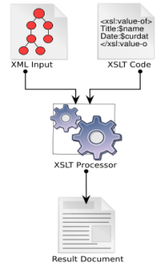

XSL Transformations
XSL

Slide 42
XSL Transformations
XSL transformations (XSLT)
Convert a XML document to another XML document with different structure
Can convert XML to any text format
Can be used to transform XML documents to XHTML
XSLT depends on XPath
For matching sections from the input document and replacing them with other text

Slide 43
Performing XSLT in .NET
.NET has built-in XSLT engine
System.Xml.Xsl.XslCompiledTransform
Methods:
Load(…)
Loads XSL shylesheet for transforming XML docs
Transform(…)
Performs transformation of given XML
Output is written to a XML file, stream or XmlWriter

Slide 44
XSL Transformation – Example
Transforming XML document by given XSL stylesheet:
using System;
using System.Xml.Xsl;
class XSLTransformDemo
{
static void Main()
{
XslCompiledTransform xslt = new XslCompiledTransform();
xslt.Load("catalog.xsl");
xslt.Transform("catalog.xml", "catalog.html");
}
}

Slide 45
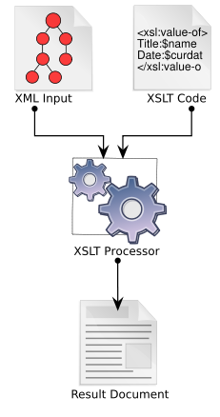

Transforming XML by XSL Stylesheet

Slide 46









Database Applications – Course Introduction
https://softuni.bg/courses/database-applications/

Slide 47
License
This course (slides, examples, demos, videos, homework, etc.) is licensed under the "Creative Commons Attribution-NonCommercial-ShareAlike 4.0 International" license
Attribution: this work may contain portions from
"Databases" course by Telerik Academy under CC-BY-NC-SA license

Slide 48





Free Trainings @ Software University
Software University Foundation – softuni.org
Software University – High-Quality Education, Profession and Job for Software Developers
softuni.bg
Software University @ Facebook
facebook.com/SoftwareUniversity
Software University @ YouTube
youtube.com/SoftwareUniversity
Software University Forums – forum.softuni.bg

